Slide 1

Semantic Search Engine

Slide 2
About Team
K.Sunitha Devi | D.Sumukha Kavya
M.C.A | B.Tech
I have around one and half years of experience as a Test Engineer. I just want to update myself with the new technology, that is the reason I have chosen Data Science. | Tech Enthusiast interested in Data Science, Machine Learning and Artificial Intelligence.

Slide 3
Agenda
Introduction
Keyword vs Semantic Search Engines
Core Logic
Data Ingestion
Document Chunking
Retrieving Documents
Conclusion

Slide 4
Introduction
Enhancing subtitle search relevance:
The primary goal of this project is to develop an advanced search engine algorithm tailored for video subtitles. By leveraging natural language processing (NLP) and machine learning techniques, we aim to improve the relevance and accuracy of search results, thereby enhancing the accessibility of video content for users.
This project focuses on developing an innovative search engine for video subtitles, leveraging cutting-edge NLP and machine learning techniques to enhance search relevance and user experience.
Importance of effective search engines:
In the digital age, search engines act as the bridge connecting users to the vast sea of information available online. An effective search engine not only simplifies this process but also enhances user experience by delivering relevant results quickly and accurately.

Slide 5
Keyword Vs Sematic Search Engines
Keyword-Based Search Engines:
These search engines rely primarily on exact keyword matches between user queries and indexed documents.
The focus is on matching specific keywords without considering the broader context or meaning behind the user's query.
Semantic Search Engines:
Semantic search engines go beyond simple keyword matching to understand the meaning, context, and intent behind user queries.
By analyzing language patterns and relationships, these engines deliver more relevant and meaningful search results.
Comparison Table:
Highlighting the key differences and advantages of semantic search engines over traditional keyword-based approaches.
Demonstrating how semantic understanding enhances search accuracy, relevance, and user satisfaction.

Slide 6
Core-Logic
Preprocessing of data:
Before comparing user queries with subtitle documents, it's essential to preprocess and clean the data to ensure consistency and accuracy.
Steps may include decoding files, removing timestamps, and handling encoding issues to prepare the data for further analysis.
Vectorization:
Transforming text data into numerical vectors using various techniques such as Bag of Words (BOW), TFIDF, or BERT-based embeddings.
Vectorization enables mathematical calculations and comparisons between user queries and subtitle documents to determine relevance.
Cosine Similarity Calculation:
Calculating the cosine similarity between the vector representations of documents and user queries to quantify their similarity.
This similarity score serves as a metric to rank and retrieve the most relevant subtitle documents based on user's search queries.

Slide 7
Data-Ingestion
Description of subtitle data:
The subtitle data provided is in a database file format, containing a collection of subtitle documents for various videos.
The dataset may include text, timestamps, and other metadata related to video subtitles, requiring specific preprocessing and decoding steps.
Steps for reading and decoding the database:
Understanding the structure and content of the database file, and implementing appropriate methods to read and decode the data effectively.
Ensuring compatibility, integrity, and consistency of the data before proceeding to cleaning and preprocessing stages.
Data cleaning and preprocessing:
Applying necessary cleaning steps to remove irrelevant information, correct errors, and standardize the subtitle text.
Preprocessing ensures the quality and consistency of the data, making it suitable for vectorization and further analysis.

Slide 8
Document-Chunking
Problem with embedding large documents:
Embedding entire subtitle documents as single vectors can lead to information loss and inefficiency, especially with long documents.
Challenges include computational limitations, potential context fragmentation, and difficulty in handling large volumes of data.
Solution: Document Chunker:
Introducing the Document Chunker method to divide large documents into smaller, manageable chunks for efficient processing and embedding.
By segmenting the text and creating overlapping windows, we can preserve context, reduce information loss, and improve embedding quality.
Overlapping windows for context preservation:
Implementing overlapping windows with a specified number of tokens to ensure continuity and shared context between document chunks.
This approach mitigates the risk of cutting off important text and maintains the semantic integrity of the original subtitle documents during embedding.

Slide 9
Vectorization-Methods
Bag of Words (BOW) / TFIDF:
Exploring traditional vectorization techniques like BOW and TFIDF to generate sparse vector representations of subtitle documents.
These methods are effective for building Keyword-Based Search Engines but may lack semantic understanding and context awareness.
BERT-based Sentence Transformers:
Leveraging advanced transformer models like BERT to generate embeddings that encode semantic information and relationships.
Sentence Transformers provide more meaningful and context-rich representations, enabling the development of a Semantic Search Engine with improved relevance and accuracy.
Pros and Cons of each method:
Comparing the advantages and limitations of BOW/TFIDF and BERT-based embeddings in terms of efficiency, accuracy, computational complexity, and semantic understanding.
Highlighting the trade-offs and considerations for selecting the most suitable vectorization method based on project requirements and objectives.

Slide 10
Chroma-DB
Storing embeddings for efficient retrieval:
Utilizing Chroma DB database to store and manage the generated embeddings of subtitle documents.
Storing embeddings in a structured database facilitates fast and scalable retrieval, optimizing search performance and user experience.
Benefits of using a database for storage:
Databases offer robustness, scalability, and efficient data retrieval capabilities compared to traditional file-based storage methods.
Chroma DB provides a reliable and organized platform for storing embeddings, enabling seamless integration with the search engine and supporting future enhancements and optimizations.

Slide 11
Retrieving-Documents
Preprocessing the user's search query:
Applying necessary preprocessing steps to the user's search query to standardize, clean, and enhance the text data for vectorization and comparison.
Ensuring consistency, accuracy, and relevance of the query to improve the quality and precision of search results.
Creating query embeddings:
Generating vector representations of the preprocessed user query using the selected vectorization method (e.g., BOW, TFIDF, BERT).
Transforms the query into a high-dimensional vector representation. This vector representation encodes information about the frequency of words, their importance in the query context, or their contextual meaning.

Slide 12
Conclusion
Summary of the project:
Developed an advanced subtitle search engine using NLP and ML, focusing on enhancing search relevance and user experience.
Achievements and challenges:
Achieved milestones in data preprocessing, vectorization, and retrieval; faced challenges in computational limitations and data quality.
Future enhancements:
Potential for integrating advanced NLP models, improving vectorization, and adding features like real-time suggestions and personalized recommendations.

Slide 13
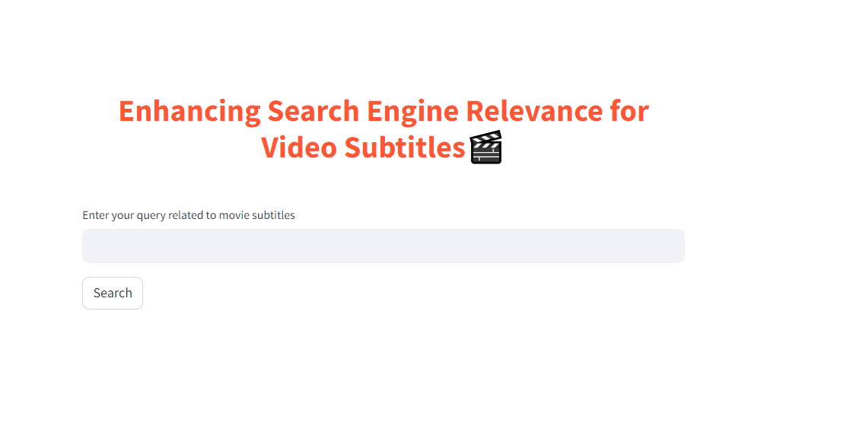
Screenshots

Slide 14
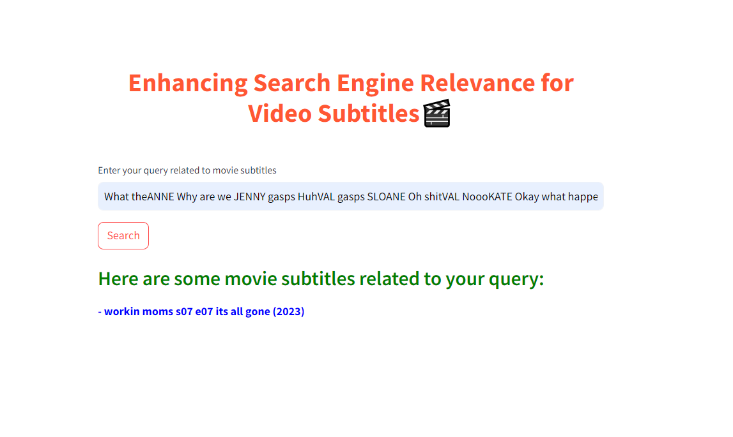
Screenshots

Slide 15

THANK YOU

